Slide 1
Discovering Relationships between Companies’ Stocks & their Internet Presence
Authors: Anna Burlyaeva, Gaurav Maheshwari

Slide 2
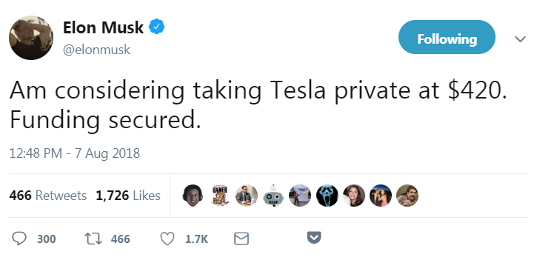

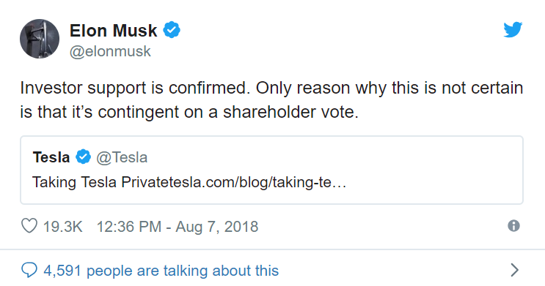
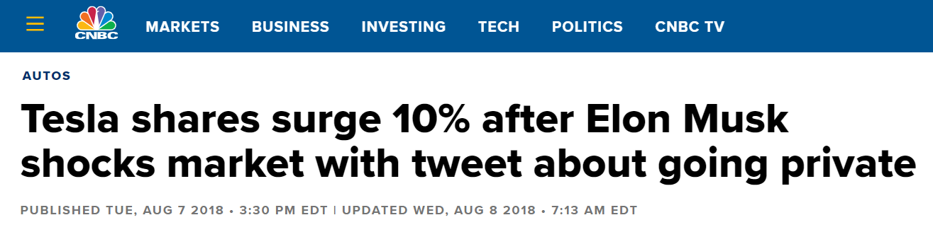
Motivation

Slide 3

Aim
To discover relationships between Company Stock Prices and their Internet Presence

Slide 4


Questions
Indicators of internet presence?
Data sources?
Relationships?
Statistical model?

Slide 5



Internet Presence Indicators
Search Queries Statistics
Twitter Posts Statistics
Online News Statistics

Slide 6

Data Sources
Data sources
Stock Data Statistics: IEX Cloud and IEX API 1.0 (https://pypi.org/project/iexfinance/)
Search Queries Statistics: Pseudo API for Google Trends (https://pypi.org/project/pytrends/)
Twitter Posts Statistics: Twitter API (https://tweepy.readthedocs.io/en/v3.5.0/)
Online News Statistics: API for searching for articles from over 30,000 news sources and blogs (https://newsapi.org/docs)

Slide 7
Tools
pandas, numpy, json, scipy, vaderSentiment, matplotlib, sklearn and various APIs libraries
Jupyter Notebook

Slide 8

Data Retrieving

Slide 9

Data Cleaning Process

Slide 10
Data for Analysis
Final DataFrame:
Company Name
Open Stock Price
Date (period: sliding one month)
Google Search Popularity Rates
Twitter Sentiments
News Sentiments

Slide 11
Visualization

Slide 12
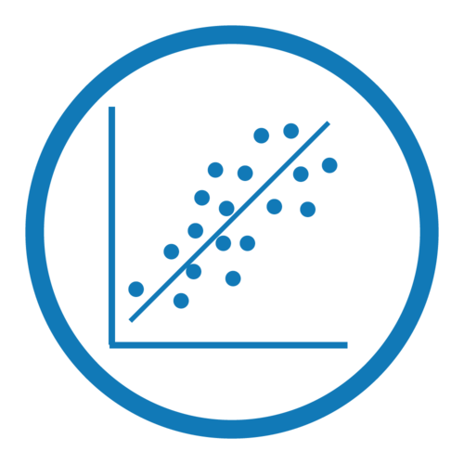
Data for Statistical Model
Dependent variable:
Open Stock Price
Independent variables:
Google Search Popularity Rate
Twitter Sentiments (3 predictors)
News Sentiments (3 predictors)

Slide 13
Model

Slide 14
Conclusion

Slide 15

Q&A
Thank you for your attention!

